Slide 1
CSC 479 Lecture 11 Image Alignment and least square methods, RANSAC
Bei Xiao
American University
April 17, 2019

Slide 2
Final project
Final project will be out this Friday.
Due May 1st.
The final websites will be shared among students!!
Cite the papers you used and the methods you implemented!! Do not copy codes form the internet!!! If you must copy one or two lines, cite the resources. Plagiarism is easy to detect these days!!

Slide 3
Reading
Appendix A.2, 6.1

Slide 4
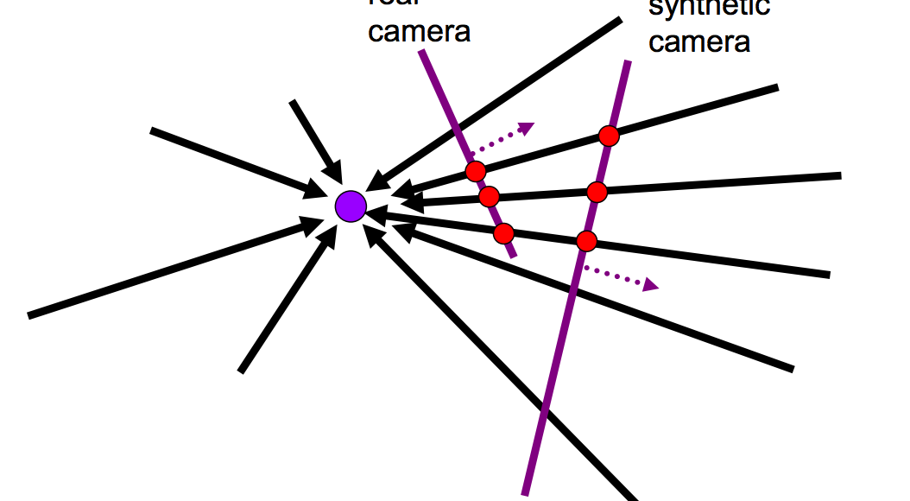
A pencil of rays contains all views
Can generate any synthetic camera view as long as it has the same center of projection

Slide 5
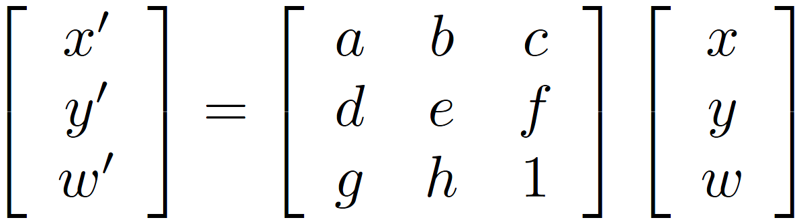
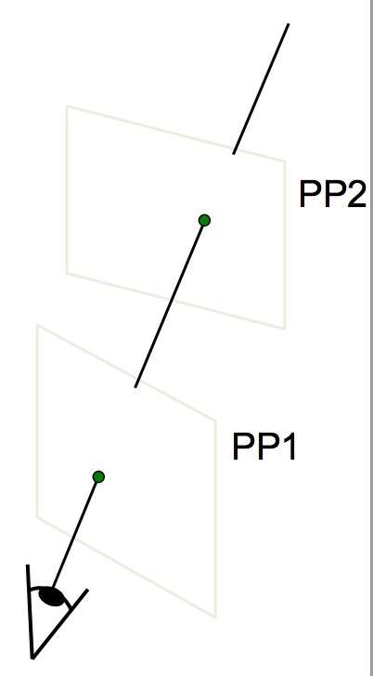
Homography
A projective-mapping between any two PPs with the same center of projection
P’
H
P
Properties of projective transformations:
Origin does not necessarily map to origin
Lines map to lines
Parallel lines do not necessarily remain parallel
Ratios are not preserved
Closed under composition

Slide 6
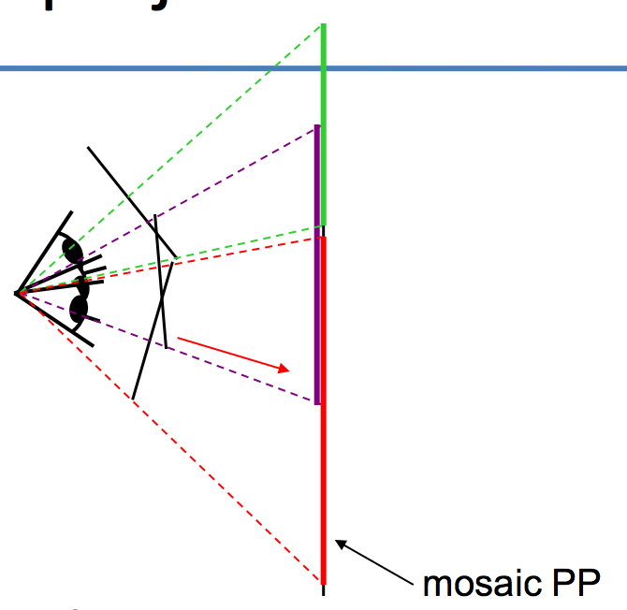
Image reprojection
The mosaic has a natural
Interpretation in 3D
The images are repojected onto a common plane
The mosaic is formed on this plane
Mosaic is a synthetic wide-angel camera

Slide 7
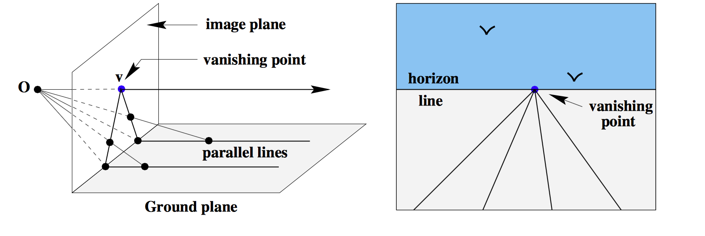

Slide 8
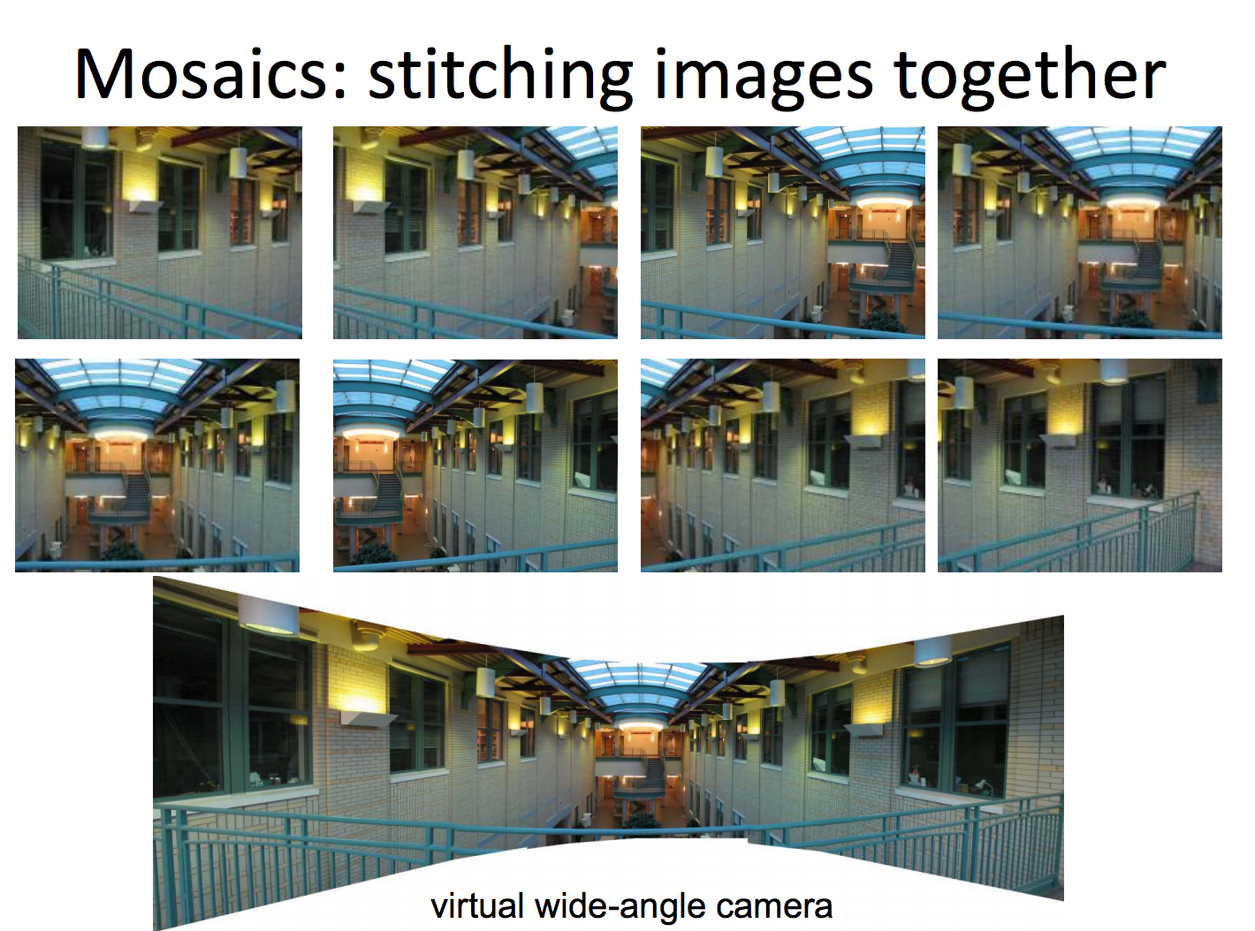

Slide 9
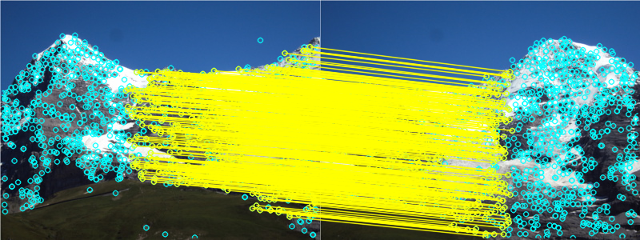
Image-stitching Steps
1. Find features (SIFT, Corners, colors)
2. Matching features.
3. Compute Homogrpahy
cv2.findHomography(srcPoints,dstPOints,cv2.RASANC).
how the second image (let’s say the image to the right) will look from the current image’s perspective
4. Warping and stitching.
Transform the second image to current image’s coordinates.
Stitch them up.

Slide 10
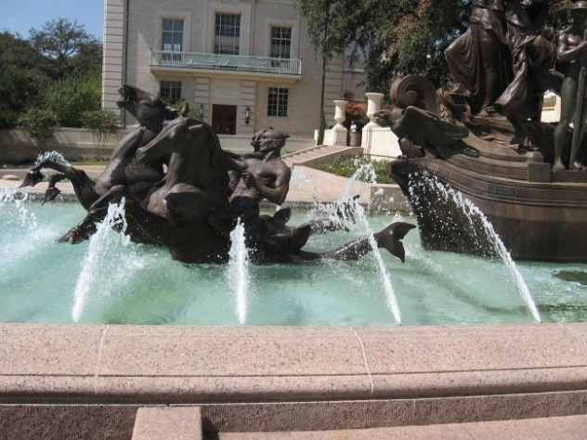
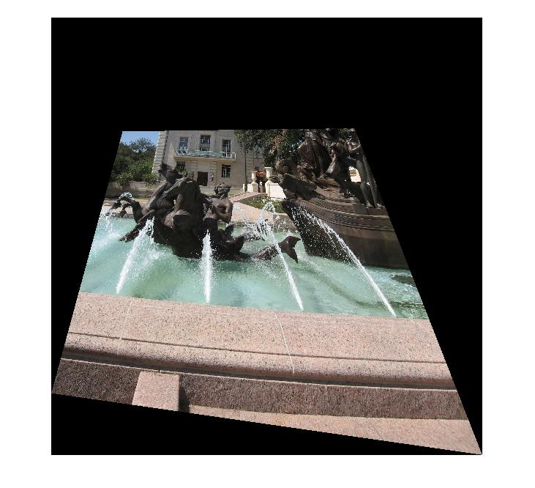
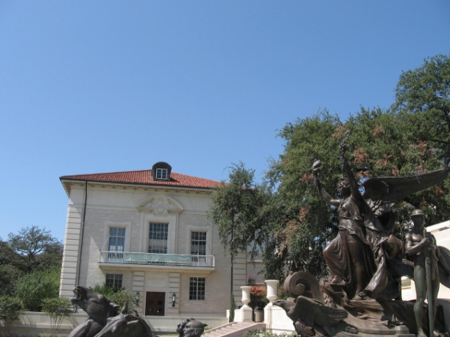
im1
im1 warped into reference frame of im2.
im2
Use interp2 to ask for the colors (possibly interpolated) from im1 at all the positions needed in im2’s reference frame.

Slide 11
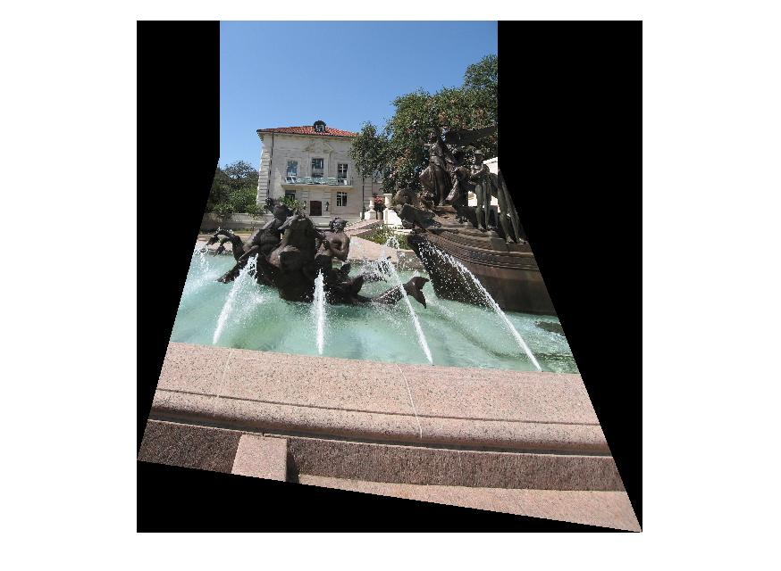

Slide 12
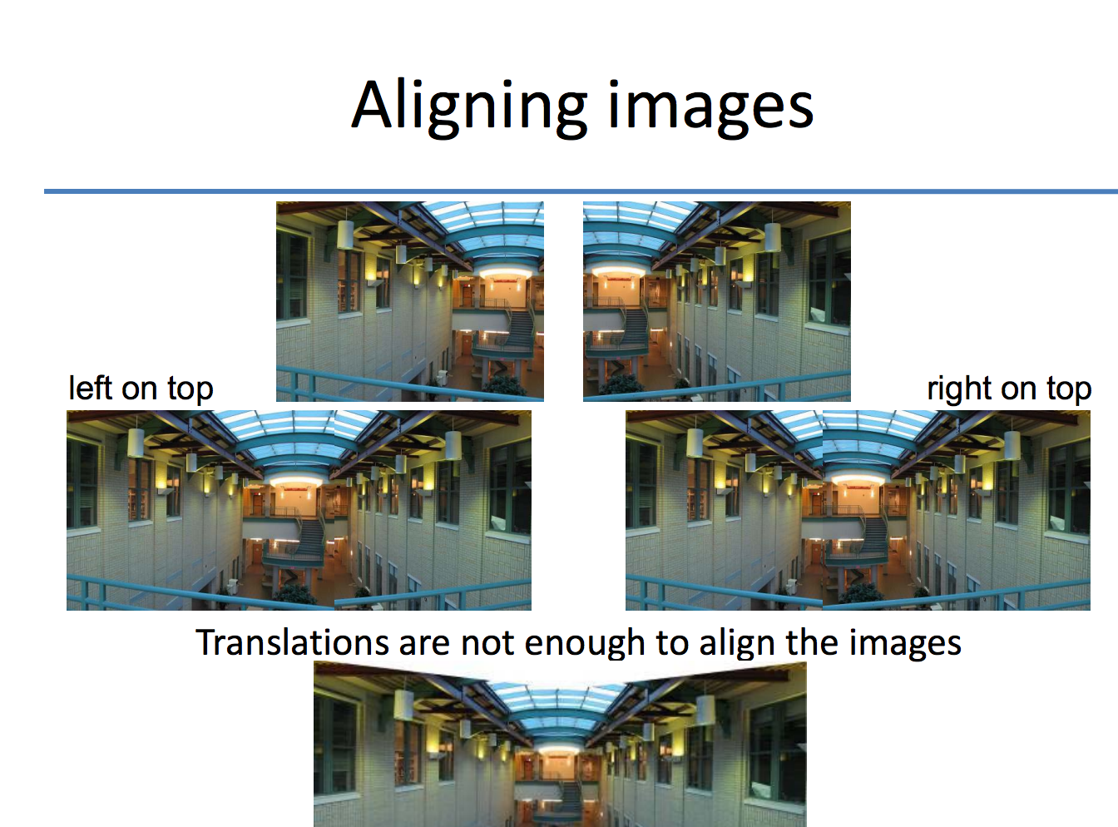
Image Alignment
http://www.inf.ethz.ch/personal/pomarc/courses/CompPhoto/cpv03.pdf

Slide 13
Mosaics: main steps
How??
Collect correspondences (manually)
Solve for homography matrix H
Least squares solution
Warp content from one image frame to the other to combine: say im1 into im2 reference frame
Determine bounds of the new combined image
Where will the corners of im1 fall in im2’s coordinate frame?
We will attempt to lookup colors for any of these positions we can get from im1. : meshgrid
Compute coordinates in im1’s reference frame (via homography) for all points in that range: H⁻¹
Lookup all colors for all these positions from im1
Inverse warp : interp2 (watch for nans : isnan)
Overlay im2 content onto the warped im1 content.
Careful about new bounds of the output image: minx, miny

Slide 14
Common problems in vision
Fitting: find the parameters of a model that best fit the data
Alignment: find the parameters of the transformation that best align matched points

Slide 15
Alignment
Alignment: find parameters of model that maps one set of points to another
Typically want to solve for a global transformation that accounts for *most* true correspondences
Difficulties
Noise (typically 1-3 pixels)
Outliers (often 50%)

Slide 16
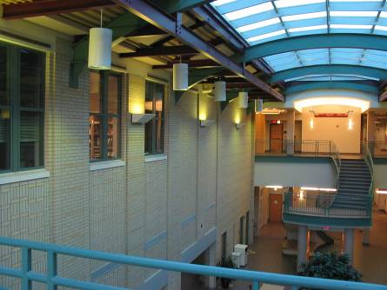
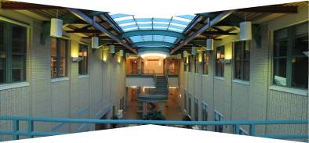
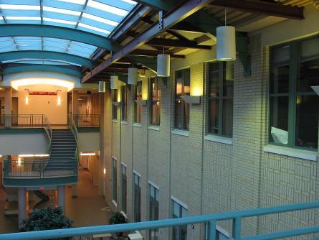
Computing transformations
?

Slide 17
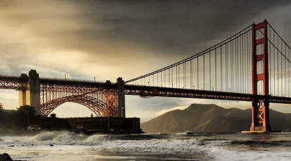
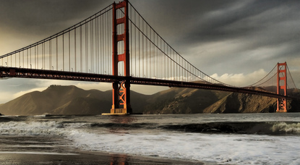
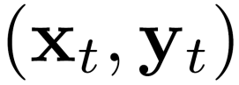
Simple case: translations
How do we solve for
?

Slide 18
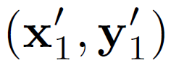
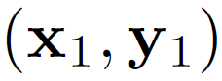
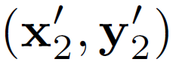
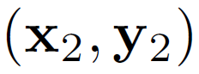
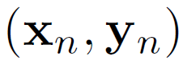
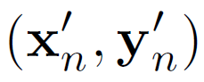
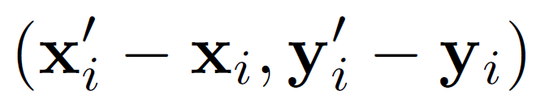
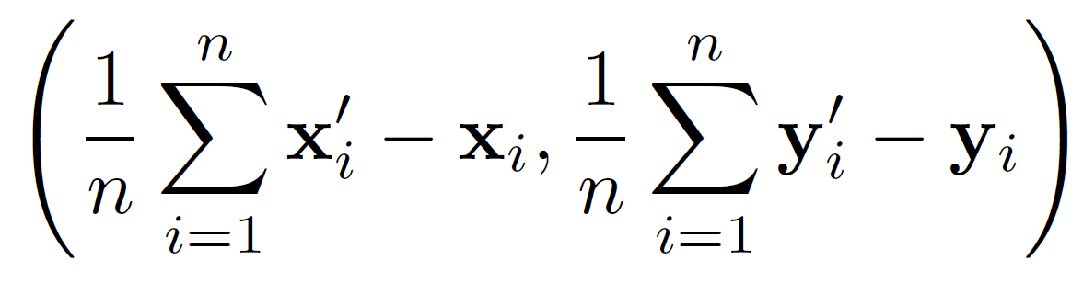
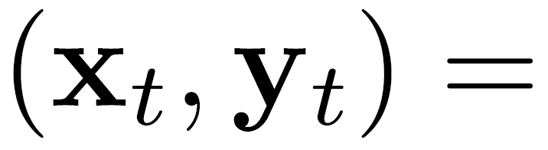
Simple case: translations
Displacement of match i =
Mean displacement =

Slide 19
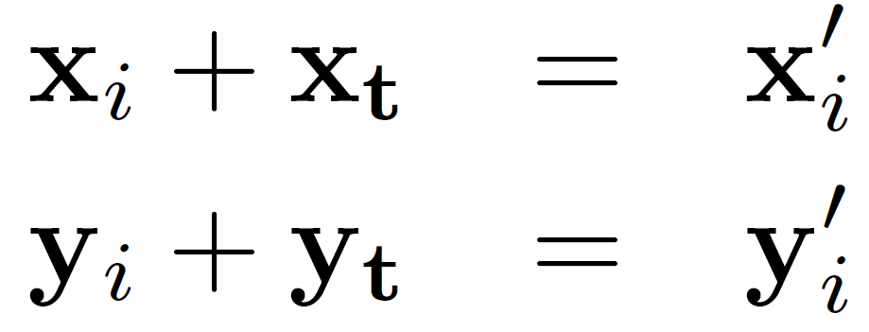
Another view
System of linear equations
What are the knowns? Unknowns?
How many unknowns? How many equations (per match)?
Notes:
2 n equations, 2 unknowns

Slide 20
Another view
Problem: more equations than unknowns
“Overdetermined” system of equations
We will find the least squares solution
Notes:
The gradient equations at the minimum can be written as (y-Xb) X
A geometrical interpretation of these equations is that the vector of residuals, is orthogonal to the column space of X, since the dot product is equal to zero for any conformal vector, v. This means that is the shortest of all possible vectors , that is, the
variance of the residuals is the minimum possible. This is illustrated at the right.

Slide 21
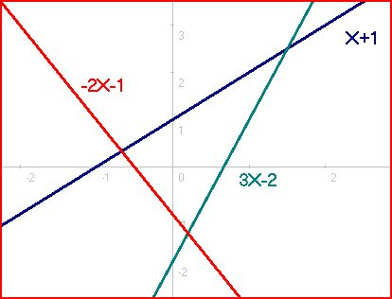
Over determined system of linear equations
One solution for each pair of lines;
No solution to satisfy all three!
https://en.wikipedia.org/wiki/Overdetermined_system

Slide 22
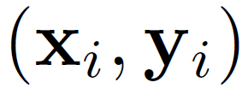
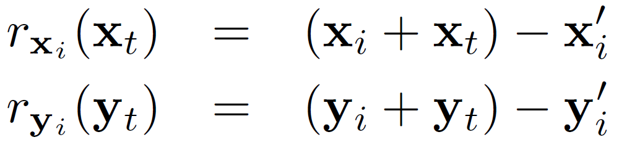
Least squares formulation
For each point
we define the residuals as

Slide 23
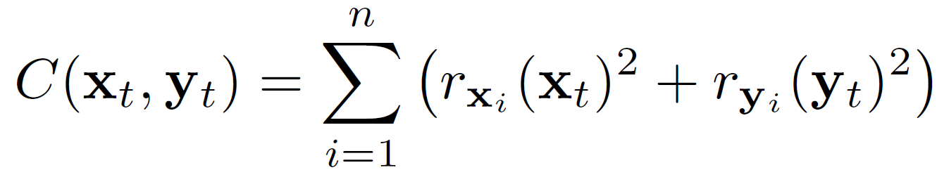
Least squares formulation
Goal: minimize sum of squared residuals
“Least squares” solution
For translations, is equal to mean displacement
Notes:
Can’t just sum the residuals. But sum of squares is used often.

Slide 24
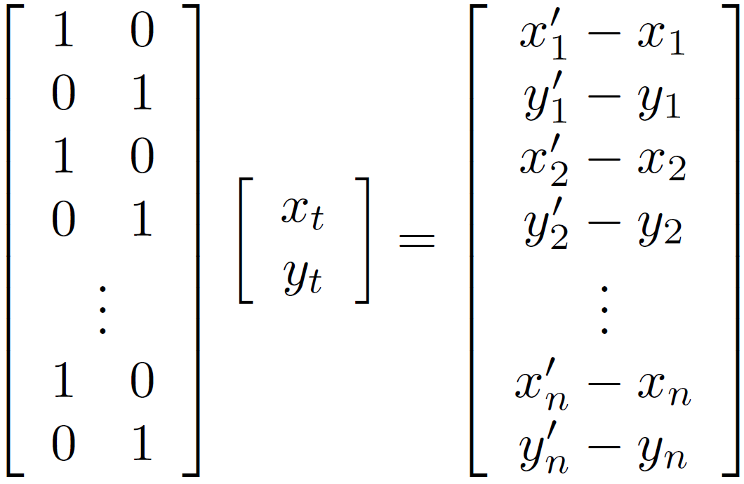



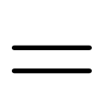
Least squares formulation
Can also write as a matrix equation
2n x 2
2 x 1
2n x 1

Slide 25
Matrix Product mini-review
http://en.wikipedia.org/wiki/Matrix_multiplication
System of linear equations
http://en.wikipedia.org/wiki/System_of_linear_equations

Slide 26
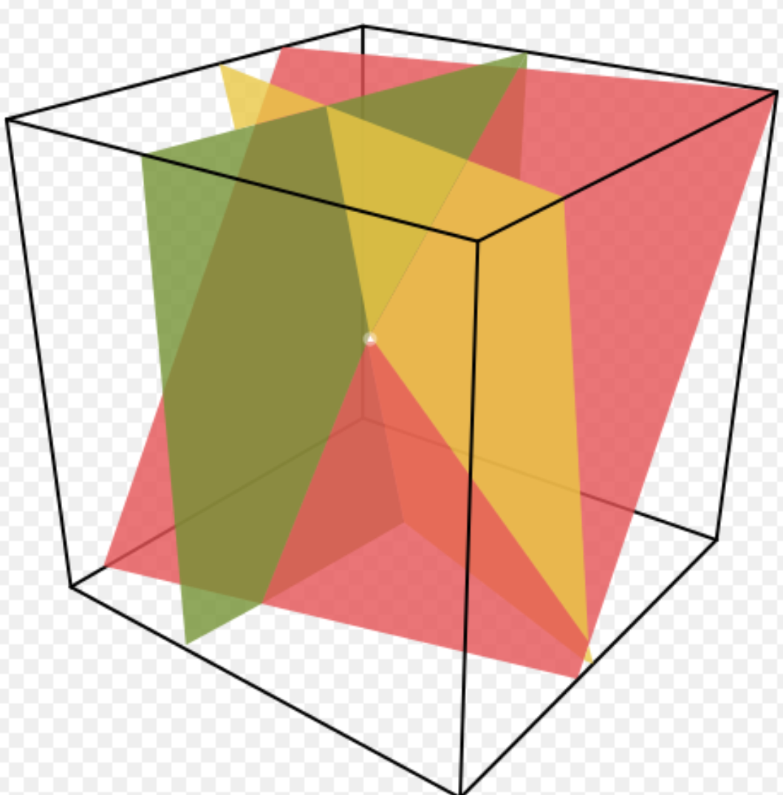
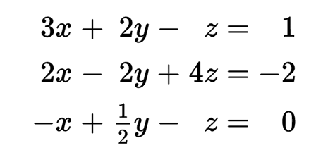
Solution is the intersections of planes

Slide 27
Matrix manipulations with Numpy
http://www.python-course.eu/matrix_arithmetic.php
https://jameshensman.wordpress.com/2010/06/14/multiple-matrix-multiplication-in-numpy/

Slide 28

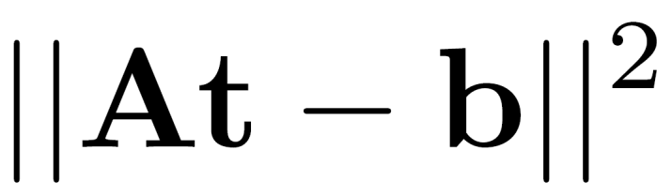
Least squares
Find t that minimizes

Slide 29
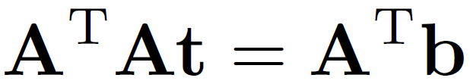
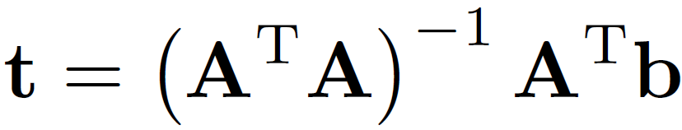
Least squares: find t to minimize
To solve, form the normal equations
Differentiate and equate to 0 to minimize
Notes:
https://www.khanacademy.org/math/ap-statistics/bivariate-data-ap/least-squares-regression/v/introduction-to-residuals-and-least-squares-regression

Slide 30
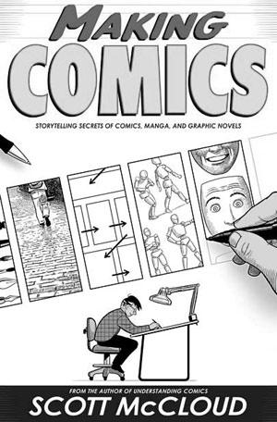
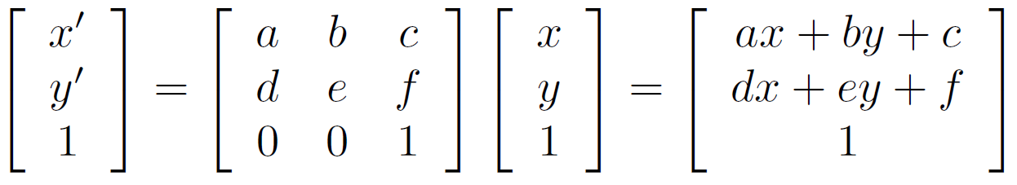
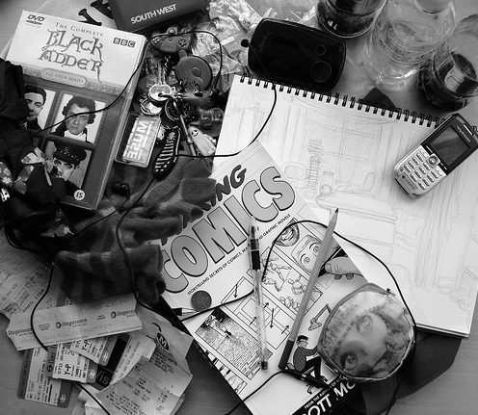
Affine transformations
How many unknowns?
How many equations per match?
How many matches do we need?
Notes:
6. 2. 3 pairss

Slide 31
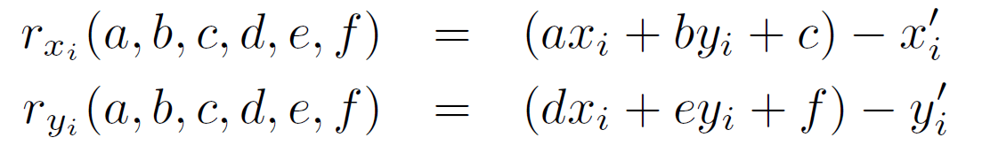
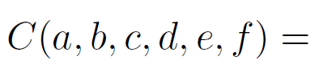
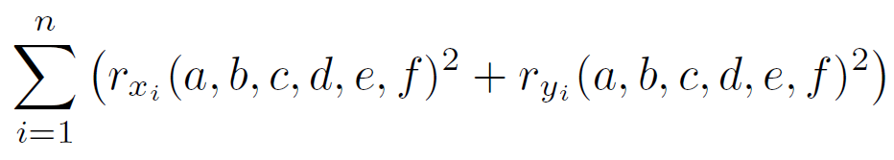
Affine transformations
Residuals:
Cost function:

Slide 32
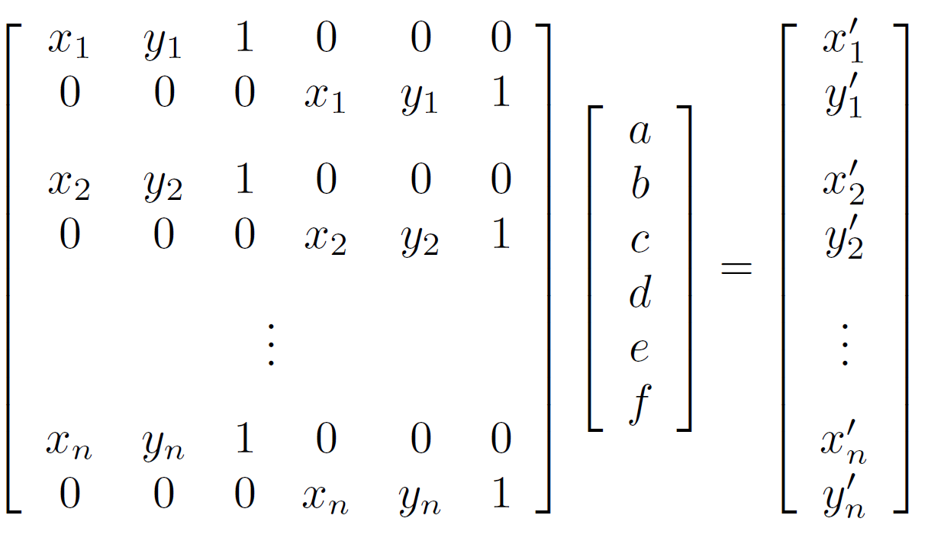
Affine transformations
Matrix form
2n x 6
6 x 1
2n x 1

Slide 33
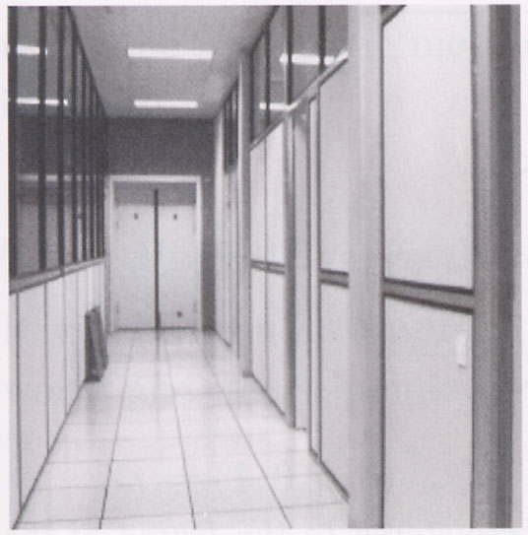
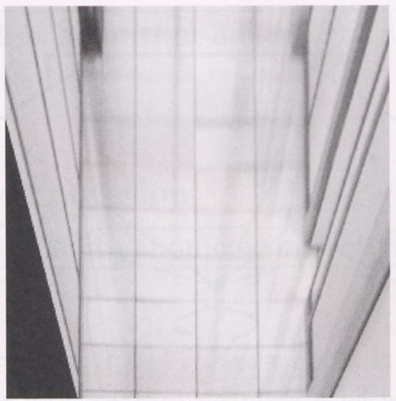
Homographies
p’
p
To unwarp (rectify) an image
solve for homography H given p and p’
solve equations of the form: p’ = Hp

Slide 34
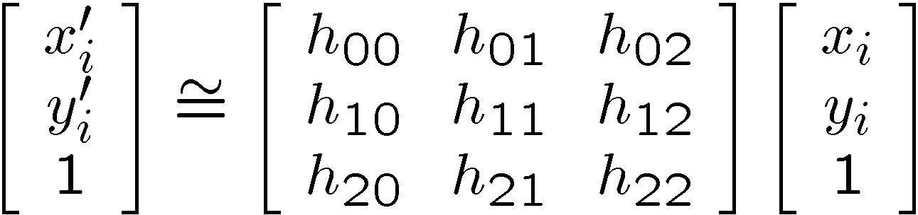
Alternate formulation for homographies
where the length of the vector [h₀₀ h₀₁ … h₂₂] is 1

Slide 35
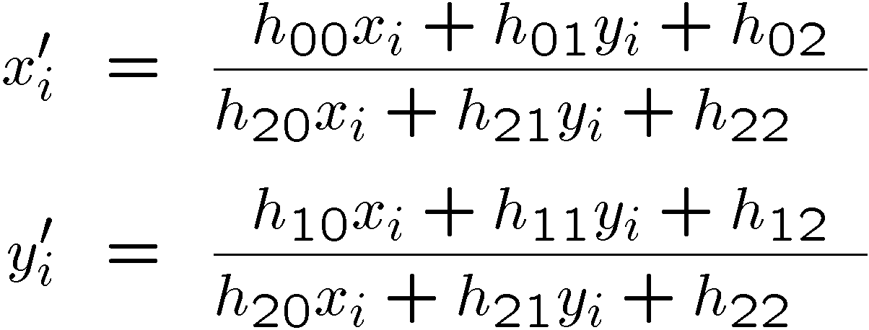
Solving for homographies
Linear or non-linear?

Slide 36

Solving for homographies
Notes:
X’ is not linear in x and y. But constraints on the h values are linear.

Slide 37

Solving for homographies
Notes:
Linear set of equations in h. Need 4 points if you add the constraint of unit norm,

Slide 38






Solving for homographies
2n × 9
9
2n
Defines a least squares problem:
Since is only defined up to scale, solve for unit vector

Slide 39
Homographies
p’
p
To unwarp (rectify) an image
solve for homography H given p and p’
solve equations of the form: p’ = Hp
linear in unknowns: coefficients of H
H is defined up to an arbitrary scale factor
how many points are necessary to solve for H?

Slide 40

Solving for homographies
2n × 9
9
2n
Defines a least squares problem:
Since is only defined up to scale, solve for unit vector
Solution: = eigenvector of with smallest eigenvalue
Works with 4 or more points

Slide 41
Recap: Two Common Optimization Problems
Problem statement
Solution
(matlab)
Problem statement
Solution

Slide 42


Slide 43
Least squares: linear regression
(y_{i}, x_{i})
y = mx + b

Slide 44

Linear regression
residual error

Slide 45

Linear regression

Slide 46
In Python
Numpy.linag.lstsq(a,b)
Solve y = mx+c
x = np.array([0,1,2,3])
y = np.array([-1,0.2,0.9.2.1])
y = Ap, where A = [[x,1]], p = [[m],[c]]
A = np.vstack([x, np.ones(len(x))]).T
m, c = np.linalg.lstsq(A, y)[0]
Or scipy.optimize.leastsq

Slide 47
Image Alignment Algorithm
Given images A and B
Compute image features for A and B
Match features between A and B
Compute homography between A and B using least squares on set of matches
What could go wrong?

Slide 48

Outliers
outliers
inliers

Slide 49

Robustness
Problem: Fit a line to these datapoints
Least squares fit

Slide 50
What can we do?
Suggestions?

Slide 51
Idea
Given a hypothesized line
Count the number of points that “agree” with the line
“Agree” = within a small distance of the line
I.e., the inliers to that line
For all possible lines, select the one with the largest number of inliers

Slide 52
Counting inliers

Slide 53
Counting inliers
Inliers: 3

Slide 54
Counting inliers
Inliers: 20

Slide 55
How do we find the best line?
Unlike least-squares, no simple closed-form solution
Hypothesize-and-test
Try out many lines, keep the best one
Which lines?

Slide 56
RANSAC
Line fitting example
Algorithm:
Sample (randomly) the number of points required to fit the model (#=2)
Solve for model parameters using samples
Score by the fraction of inliers within a preset threshold of the model
Repeat 1-3 until the best model is found with high confidence
Illustration by Savarese
Notes:
Let me give you an intuition of what is going on. Suppose we have the standard line fitting problem in presence of outliers.
We can formulate this problem as follows: want to find the best partition of points in inlier set and outlier set such that…
The objective consists of adjusting the parameters of a model function so as to best fit a data set.
"best" is defined by a function f that needs to be minimized.
Such that the best parameter of fitting the line give rise to a residual error lower that delta
as when the sum, S, of squared residuals

Slide 57
RANSAC
Line fitting example
Algorithm:
Sample (randomly) the number of points required to fit the model (#=2)
Solve for model parameters using samples
Score by the fraction of inliers within a preset threshold of the model
Repeat 1-3 until the best model is found with high confidence
Notes:
Let me give you an intuition of what is going on. Suppose we have the standard line fitting problem in presence of outliers.
We can formulate this problem as follows: want to find the best partition of points in inlier set and outlier set such that…
The objective consists of adjusting the parameters of a model function so as to best fit a data set.
"best" is defined by a function f that needs to be minimized.
Such that the best parameter of fitting the line give rise to a residual error lower that delta
as when the sum, S, of squared residuals

Slide 58
RANSAC
Line fitting example
Algorithm:
Sample (randomly) the number of points required to fit the model (#=2)
Solve for model parameters using samples
Score by the fraction of inliers within a preset threshold of the model
Repeat 1-3 until the best model is found with high confidence
Notes:
Let me give you an intuition of what is going on. Suppose we have the standard line fitting problem in presence of outliers.
We can formulate this problem as follows: want to find the best partition of points in inlier set and outlier set such that…
The objective consists of adjusting the parameters of a model function so as to best fit a data set.
"best" is defined by a function f that needs to be minimized.
Such that the best parameter of fitting the line give rise to a residual error lower that delta
as when the sum, S, of squared residuals

Slide 59
RANSAC
Algorithm:
Sample (randomly) the number of points required to fit the model (#=2)
Solve for model parameters using samples
Score by the fraction of inliers within a preset threshold of the model
Repeat 1-3 until the best model is found with high confidence
Notes:
Let me give you an intuition of what is going on. Suppose we have the standard line fitting problem in presence of outliers.
We can formulate this problem as follows: want to find the best partition of points in inlier set and outlier set such that…
The objective consists of adjusting the parameters of a model function so as to best fit a data set.
"best" is defined by a function f that needs to be minimized.
Such that the best parameter of fitting the line give rise to a residual error lower that delta
as when the sum, S, of squared residuals

Slide 60
RANSAC
Idea:
All the inliers will agree with each other on the translation vector; the (hopefully small) number of outliers will (hopefully) disagree with each other
RANSAC only has guarantees if there are < 50% outliers
“All good matches are alike; every bad match is bad in its own way.”
– Tolstoy via Alyosha Efros

Slide 61

Translations

Slide 62
RAndom SAmple Consensus
Select one match at random, count inliers

Slide 63
RAndom SAmple Consensus
Select another match at random, count inliers

Slide 64
RAndom SAmple Consensus
Output the translation with the highest number of inliers

Slide 65
Final step: least squares fit
Find average translation vector over all inliers

Slide 66
RANSAC
Inlier threshold related to the amount of noise we expect in inliers
Often model noise as Gaussian with some standard deviation (e.g., 3 pixels)
Number of rounds related to the percentage of outliers we expect, and the probability of success we’d like to guarantee
Suppose there are 20% outliers, and we want to find the correct answer with 99% probability
How many rounds do we need?

Slide 67
How many rounds?
If we have to choose k samples each time
with an inlier ratio p
and we want the right answer with probability P
 | proportion of inliers p
k | 95% | 90% | 80% | 75% | 70% | 60% | 50%
2 | 2 | 3 | 5 | 6 | 7 | 11 | 17
3 | 3 | 4 | 7 | 9 | 11 | 19 | 35
4 | 3 | 5 | 9 | 13 | 17 | 34 | 72
5 | 4 | 6 | 12 | 17 | 26 | 57 | 146
6 | 4 | 7 | 16 | 24 | 37 | 97 | 293
7 | 4 | 8 | 20 | 33 | 54 | 163 | 588
8 | 5 | 9 | 26 | 44 | 78 | 272 | 1177
P = 0.99
Source: M. Pollefeys

Slide 68

 | proportion of inliers p
k | 95% | 90% | 80% | 75% | 70% | 60% | 50%
2 | 2 | 3 | 5 | 6 | 7 | 11 | 17
3 | 3 | 4 | 7 | 9 | 11 | 19 | 35
4 | 3 | 5 | 9 | 13 | 17 | 34 | 72
5 | 4 | 6 | 12 | 17 | 26 | 57 | 146
6 | 4 | 7 | 16 | 24 | 37 | 97 | 293
7 | 4 | 8 | 20 | 33 | 54 | 163 | 588
8 | 5 | 9 | 26 | 44 | 78 | 272 | 1177
P = 0.99
Notes:
(1-(1-e)^s)^N = 1-p
(1-e)^s = all inliers
1-above = proba that at least one of them is not an inlier. So you have to reject it.
Say you reject this N times.
And then you finally accept it.

Slide 69


How big is k?
For alignment, depends on the motion model
Here, each sample is a correspondence (pair of matching points)

Slide 70
RANSAC pros and cons
Pros
Simple and general
Applicable to many different problems
Often works well in practice
Cons
Parameters to tune
Sometimes too many iterations are required
Can fail for extremely low inlier ratios
We can often do better than brute-force sampling

Slide 71
RANSAC
An example of a “voting”-based fitting scheme
Each hypothesis gets voted on by each data point, best hypothesis wins
There are many other types of voting schemes
E.g., Hough transforms…

Slide 72
Hough transform
P.V.C. Hough, Machine Analysis of Bubble Chamber Pictures, Proc. Int. Conf. High Energy Accelerators and Instrumentation, 1959
Given a set of points, find the curve or line that explains the data points best
y
m
x
b
Hough space
y = m x + b
Slide from S. Savarese
Notes:
• A line is represented as . Every line in the image corresponds to a point in the parameter space
Every point in m, b is a line in x, y.
Dual space.
Every point in x, y. Instantiate it and works out to a line in m, b
• Every point in the image domain corresponds to a line in the parameter
space (why ? Fix (x,y), (m,n) can change on the line . In other
words, for all the lines passing through (x,y) in the image space, their
parameters form a line in the parameter space)
• Points along a line in the space correspond to lines passing through the
same point in the parameter space (why ?)

Slide 73
Hough Transform: Outline
Create a grid of parameter values
Each point votes for a set of parameters, incrementing those values in grid
Find maximum or local maxima in grid

Slide 74
Hough transform
y
m
x
b
y
m
3
5
3
3
2
2
3
7
11
10
4
3
2
3
1
4
5
2
2
1
0
1
3
3
x
b
Slide from S. Savarese
Notes:
• Points along a line in the space correspond to lines passing through the same point in the parameter space (why ?)

Slide 75


Slide 76



Hough transform
d
θ

Slide 77
Fitting Summary
Least Squares Fit
closed form solution
robust to noise
not robust to outliers
Hough transform
robust to noise and outliers
can fit multiple models
only works for a few parameters (1-4 typically)
RANSAC
robust to noise and outliers
works with a moderate number of parameters (e.g, 1-8)

